Slide 1



Subhadip Samanta IIFT Delhi

Slide 2
ADDRESSABLE MARKET
0-18 Yrs
(30%)
College Students (20%)
Prefer Adventure Trips (65%)
Prefer Non-Adventure Trips
(35%)
Urban
(40%)
Prefer Adventure Trips (40%)
Total
Population
18-40 Yrs
(40%)
Working People (80%)
Prefer Non-Adventure Trips (60%)
Working People (40%)
Prefer Adventure Trips (20%)
Prefer Non-Adventure Trips (80%)
Rural (60%)
Prefer Adventure Trips (10%)
40-70 Yrs
(30%)
: To be considered in addressable market
Retired
(60%)
Prefer Non-Adventure Trips (90%)

Slide 3
ADDRESSABLE MARKET
Some Assumptions
Calculations
~40% Urban Population in India
Lesser population in rural india goes for vacations, so not considered
60% of urban population – Plans at least 1 trip/year and/or Plans to go for a trip
Evaluating the audience & market
Total Urban Population = 135 Cr * 0.4 = 54 Cr
18-40 Year Olds
Population = 0.4 * 54 Cr = 21.6 Cr
60% plan a trip = 0.6 * 21.6 Cr = 12.96 Cr
a. College Students favouring adventure trips = 0.2 * 0.65 * 12.96 =
1.68 Cr
b. Working professionals favouring adventure trips = 0.8 * 0.4 *
12.96 = 4.25 Cr
High Demand for Adventure Tourism
Young Trekking Enthusiasts
Mature Trekking Enthusiasts
Young & energetic People a.
Prefer Adventurous physical challenges
Interested in higher risk
treks
Even though their main holiday focus lies on trekking, they are not directly thrill seekers
b. They are generally fit and active travellers
Demand
40 – 70 Year Olds
Population = 0.3 * 54 Cr = 16.2 Cr
60% plan a trip = 0.6 * 16.2 Cr = 9.72 Cr
a. Working professionals favouring adventure trips = 0.4 * 0.2 * 9.72
= 0.776 Cr
a. Retired people favouring adventure trips = 0.6 * 0.1 * 9.72 = 0.5
Cr
18
Age
70
Mature Leisure Trekking Travellers
Young Leisure Trekking Travellers
Young & energetic
Likely to task risks within limits
Influenced by good deals
Require few days of leisure
towards end of trek
Experienced trekking during youth and still continue
Bigger budget, prefer
known tour operators
Not too adventurous, low risk activities
Market Size = 7.2 Cr
Sources : https://www.livemint.com/Consumer/1oPnkPjZgoHFAhH7lqqPOK/How-many- Indians-travel.html | https://blog.townscript.com/promoting-your-trekking-hiking-business/

Slide 4
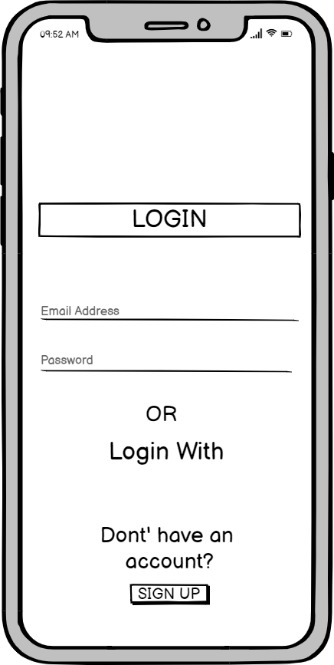
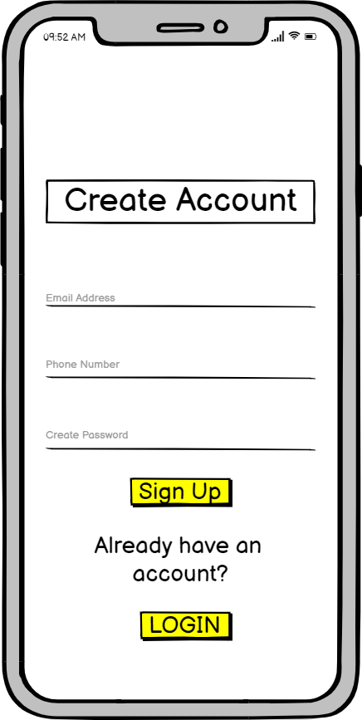



WIREFRAMES
The first page will be a simple login page
The customer will be given an option to login
through email address/phone number, or via social
media handles
The sign up page would consist of minimum details so that the customer’s time is saved while creating a new profile
/ Phone number
LOGIN

Slide 5
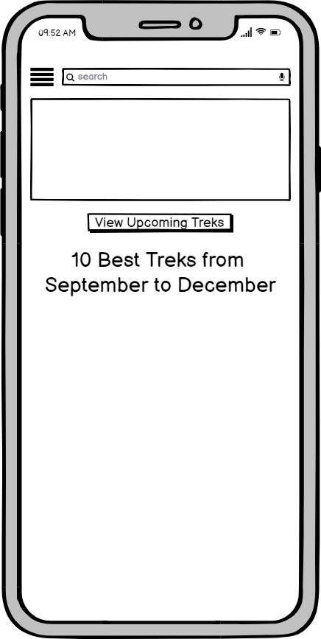
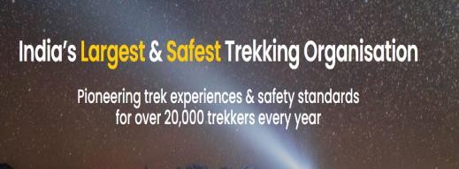
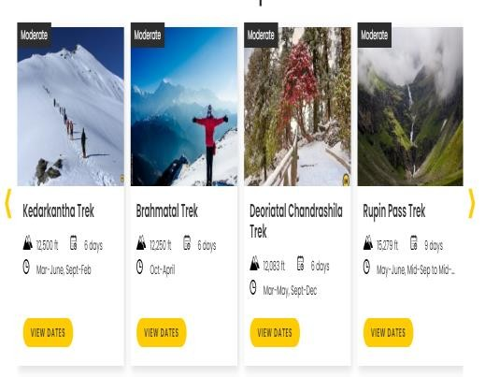
WIREFRAMES
The sidebar menu option will give the options to user to choose from, which are currently on the website too.
The options would be:
Upcoming Treks
Blogs
DIY Treks
Treks for family & Kids
Treks for Students
The search tab will enable user to search directly for a location, or the type of trek they are looking for.
The search will give the desired
results (as on the next slide)
After logging in, the home page will
have the same content as on the
website.
The page will be vertically scrollable

Slide 6

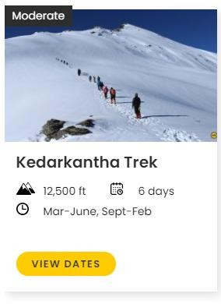
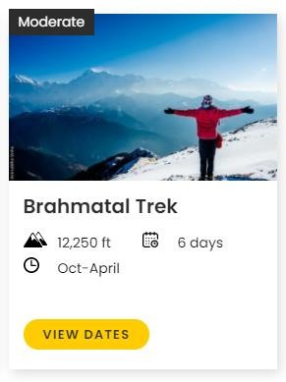
WIREFRAMES
The filter button will enable the user to filter the search results in
following criteria further:
By Difficulty
By Seasons
By Months
By Regions
If the search has already been
made as per one of the criteria, that particular option will already be selected, and more options could be selected
The desired results will be shown this way
These can be selected to further redirect the user to take them to the page where the details can be found about the particular trek

Slide 7
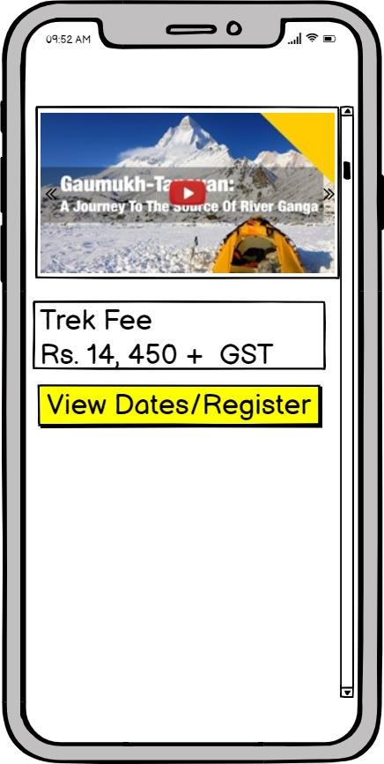
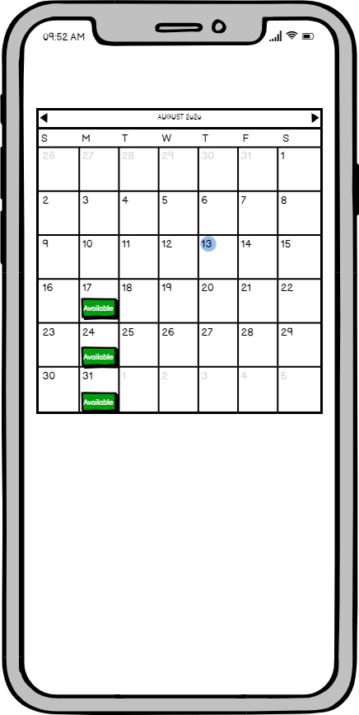
WIREFRAMES
The content will be shown in horizontal scrollable area, about the place, its videos, and pictures
Clicked on View Dates/Register
The screen will show the calendar with clickable available buttons.
When the user clicks on them, they will be redirected to a form to fill the required details post which they can checkout
Clicking this button will redirect the user to a calendar to show the available dates
This is how the page will be
when the user particular trek
The content for photos, videos,
clicks on a
the trek –
blogposts,
FAQs, etc. will be on the page, as well as the cost, and CTA button to register for the trek

Slide 8
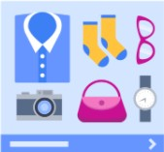
MONETIZATION MODEL - 1
The majority revenue will be from organizing treks – Approx. 65-70% revenue
1. Advertisements/Sponsored Posts on the app
Sponsored/Promoted Ads on the app – Banner Ads
The size will be of 300x50 or 320x50
These ads will have CTA buttons so as to redirect the user to site/app of the ad
Main content
The revenue collection from ads would be between 10-20% approx.
Ads can go on all pages, except checkout and the main trekking page, since we do not want to give user a cluttered experience
Sponsored
Sponsored Post

Slide 9
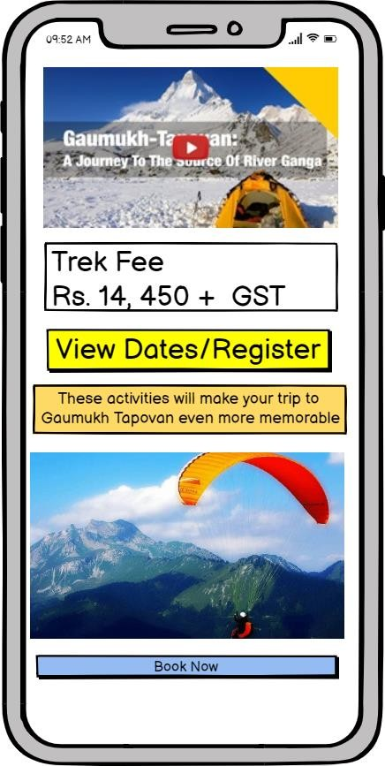
MONETIZATION MODEL - 2
2. Adventure Activities
These adventure activities will be shown in the app with partnership with activities’ organisers of locations where India Hikes organizes treks already
On Booking these activities after getting redirected by India Hikes app, the partner company would pay a fee for redirecting our users to their site/app to make a purchase (Affiliate)
The revenue sourced through these will be approximately 10-15%
The suggestions will be present on the page where trek details are
mentioned

Slide 10
METRICS TO CONSIDER
Download & Launch Rate : Download and launch rates will clearly show whether the offering resonates with users enough to make them try out our solution.
User Ratings & Store : Naturally, the company will aim for a high score in store but user ratings are a good source of
feedback. Rating click-through is important as well. Also, is the app easy to find on the store or not.
Customer Acquisition Cost : How much does it cost to get a new user, as well as a paying customer, per se too.
Number of new sign ups : How many people have actually created the account
Percentage of active users : Daily active users and Monthly Active Users, to measure Stickiness
Churn : Percentage of people who uninstall app or stop using it weekly, monthly, etc.

Slide 11
THANK YOU!
India’s largest & Safest
Trekking Organization

